Slide 1

Assisting doctors to save lives with Alfresco & Xedoc
Victor Fariña
CEO @QueresTic

Slide 2
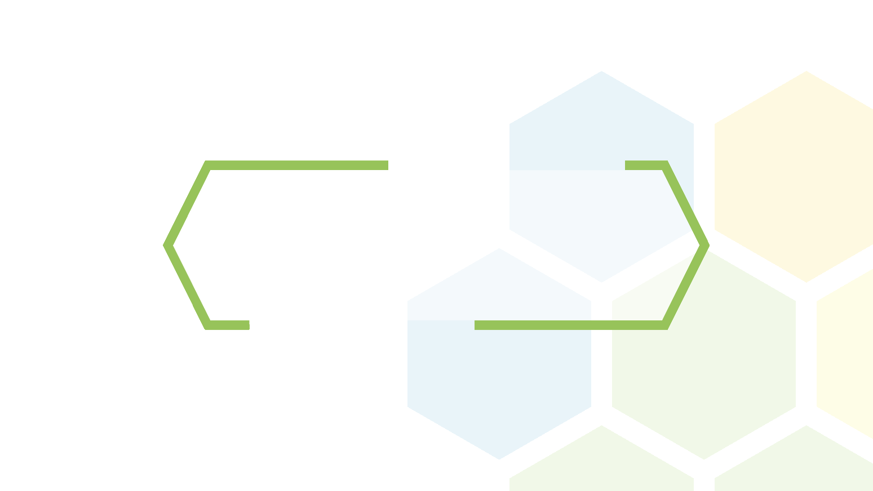
Disclaimer

Slide 3

Non technical track
Notes:
This is not a technical track, i will talk about BORING things like USERS, USE CASES & OTHER STUFF

Slide 4
Introduction

Slide 5

Team
…
…
20 people

Slide 6
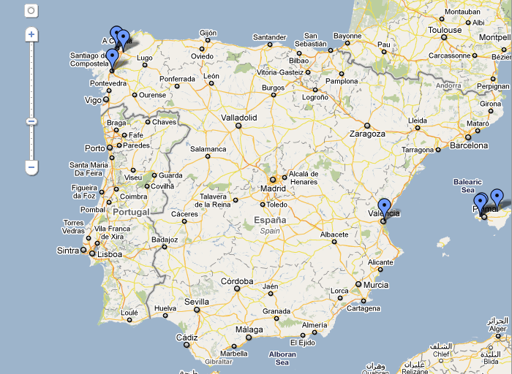

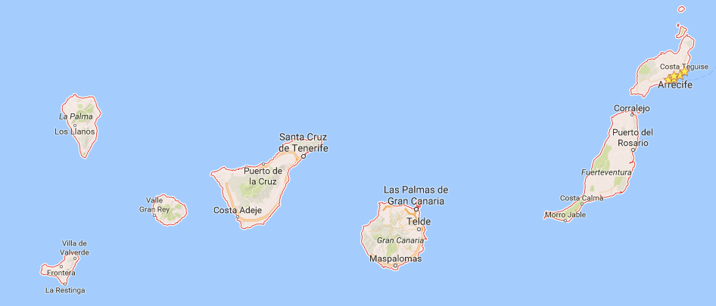
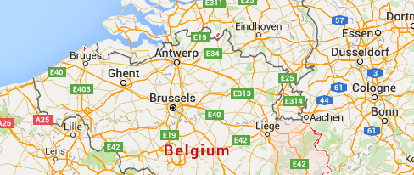
What do we expect in 2017?

Slide 7

> 10 years
> 10 years

Slide 8
Half of the Company are certified
Alfresco Partners since version 1.4 (2006)
Notes:
In fact the first implementation was in a beer company with 1.4 version and is still working growing sice 2006 until now under a 4.2 repository version

Slide 9

What do we expect in 2017?
> 15 years

Slide 10







Slide 11
Main Pain

Slide 12
Peter
Notes:
Peter suffers a disease called Systemic Lupus that was very rare before 2000

Slide 13
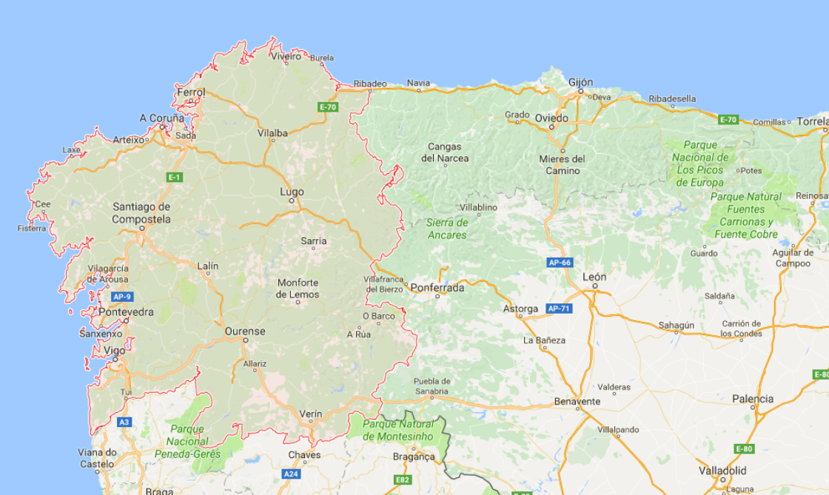





Notes:
MRI (Magnetic Resonance Imaging)

Slide 14
What do we expect in 2017?
8 years of tests

Slide 15
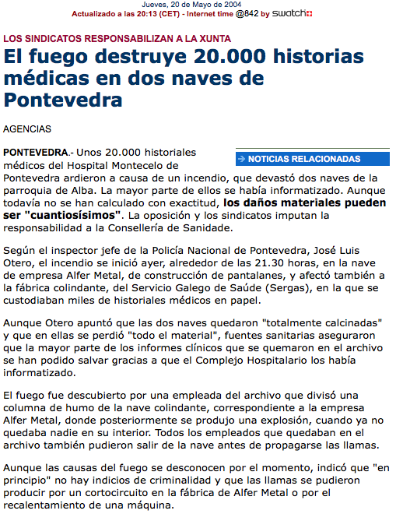
What do we expect in 2017?
2004
20k patient affected

Slide 16
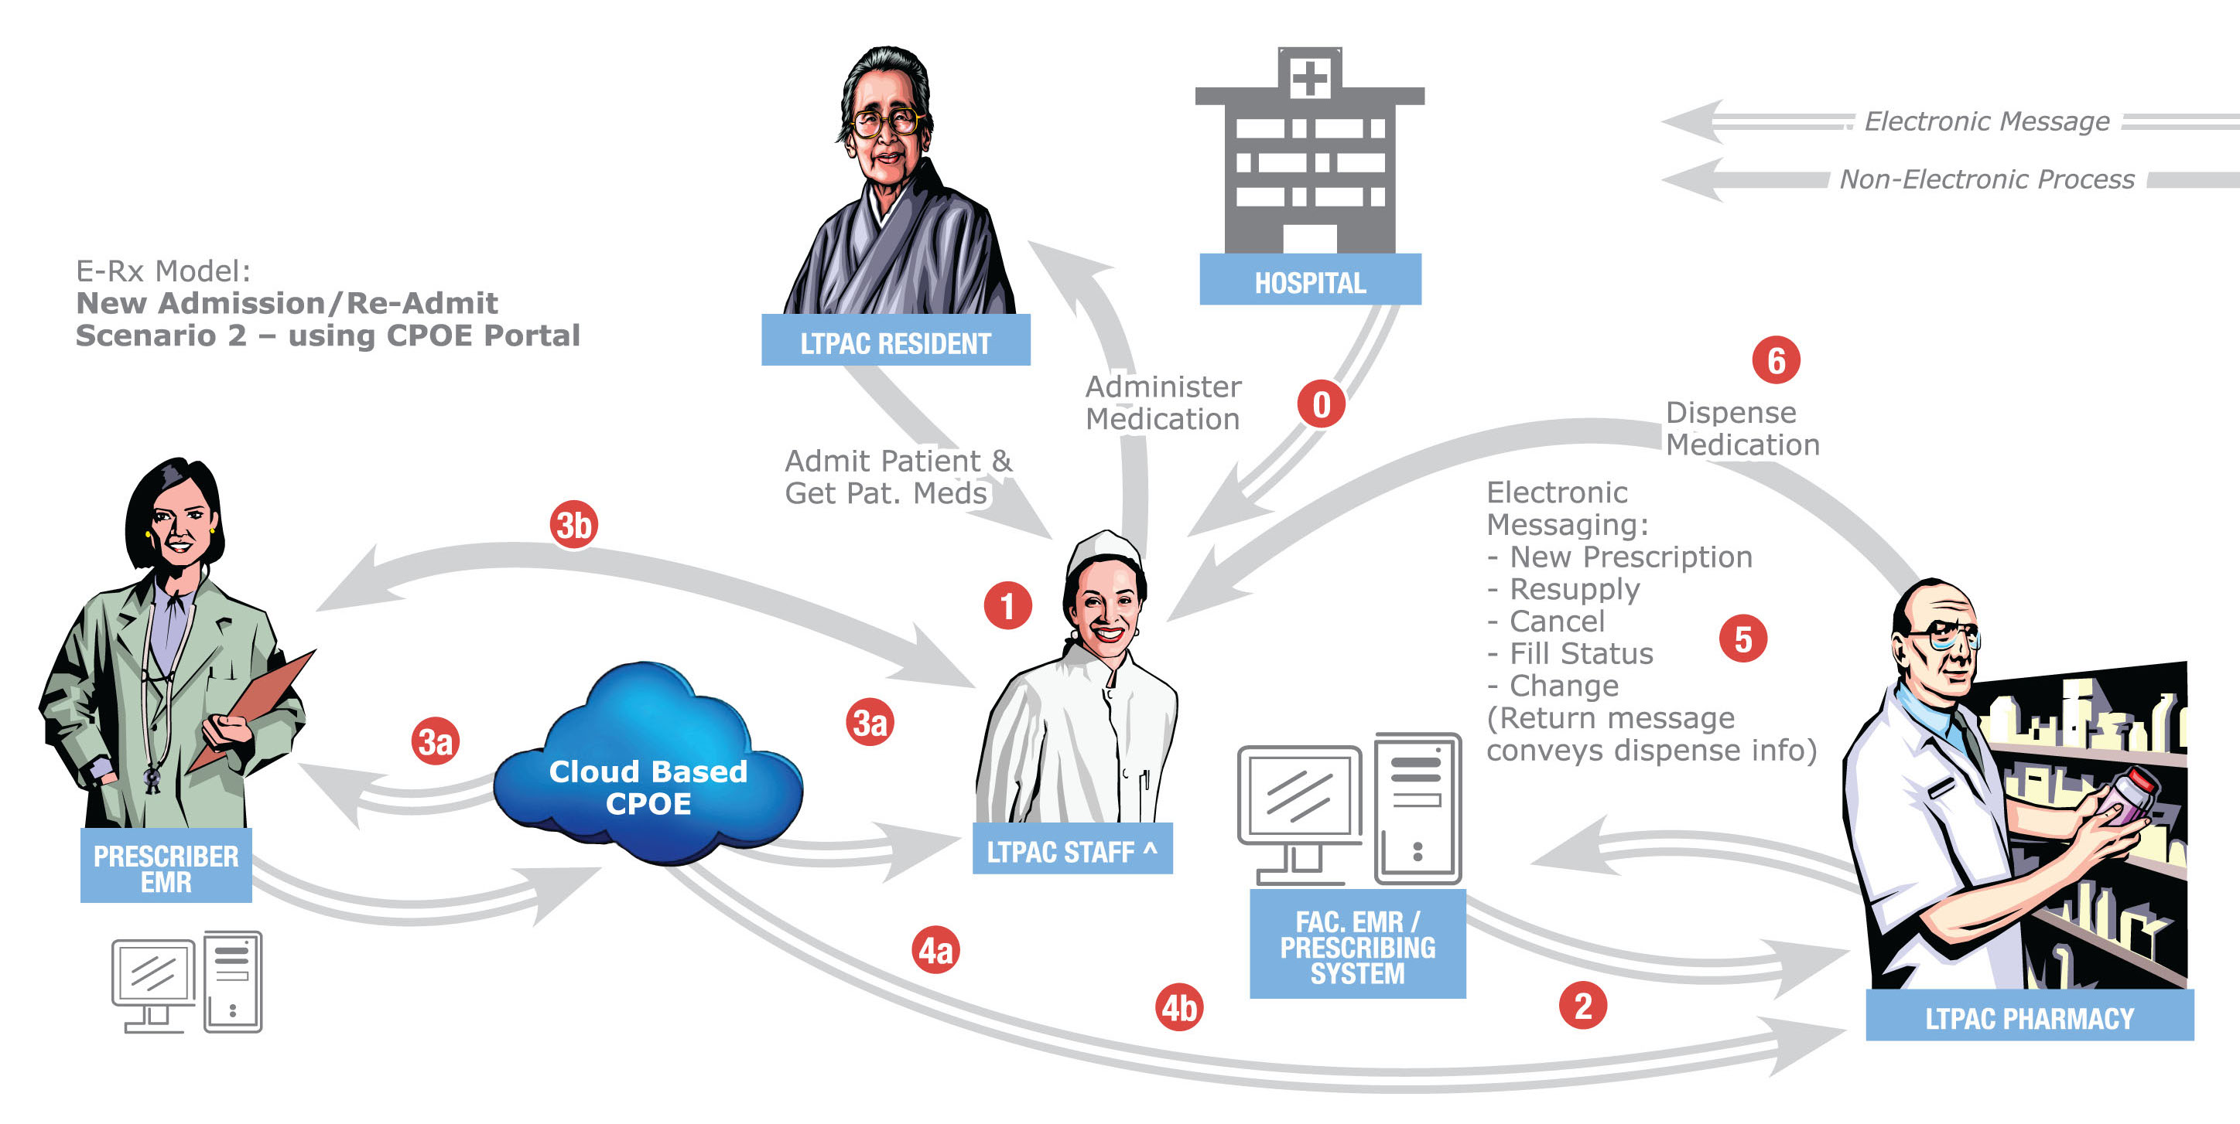
Practicioner access
Access from another hospital, ER, etc …

Slide 17
Patient access

Slide 18
Access to our EHR in other cities
Access to your EHR on holidays

Slide 19
EHR
2004-2010

Slide 20
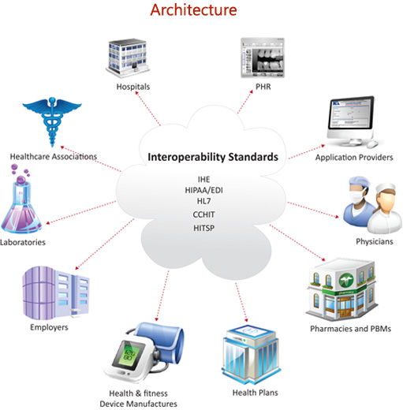
2012

Slide 21
Approach

Slide 22
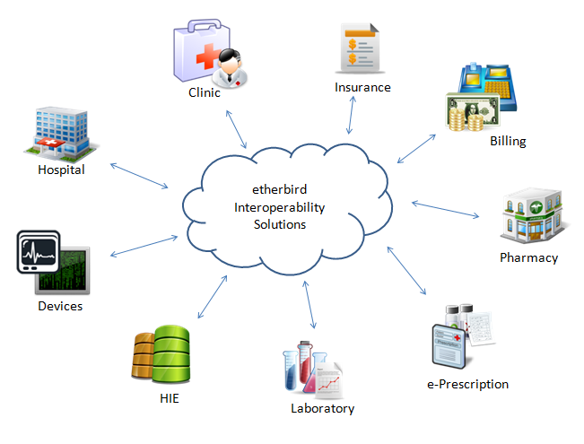

Slide 23
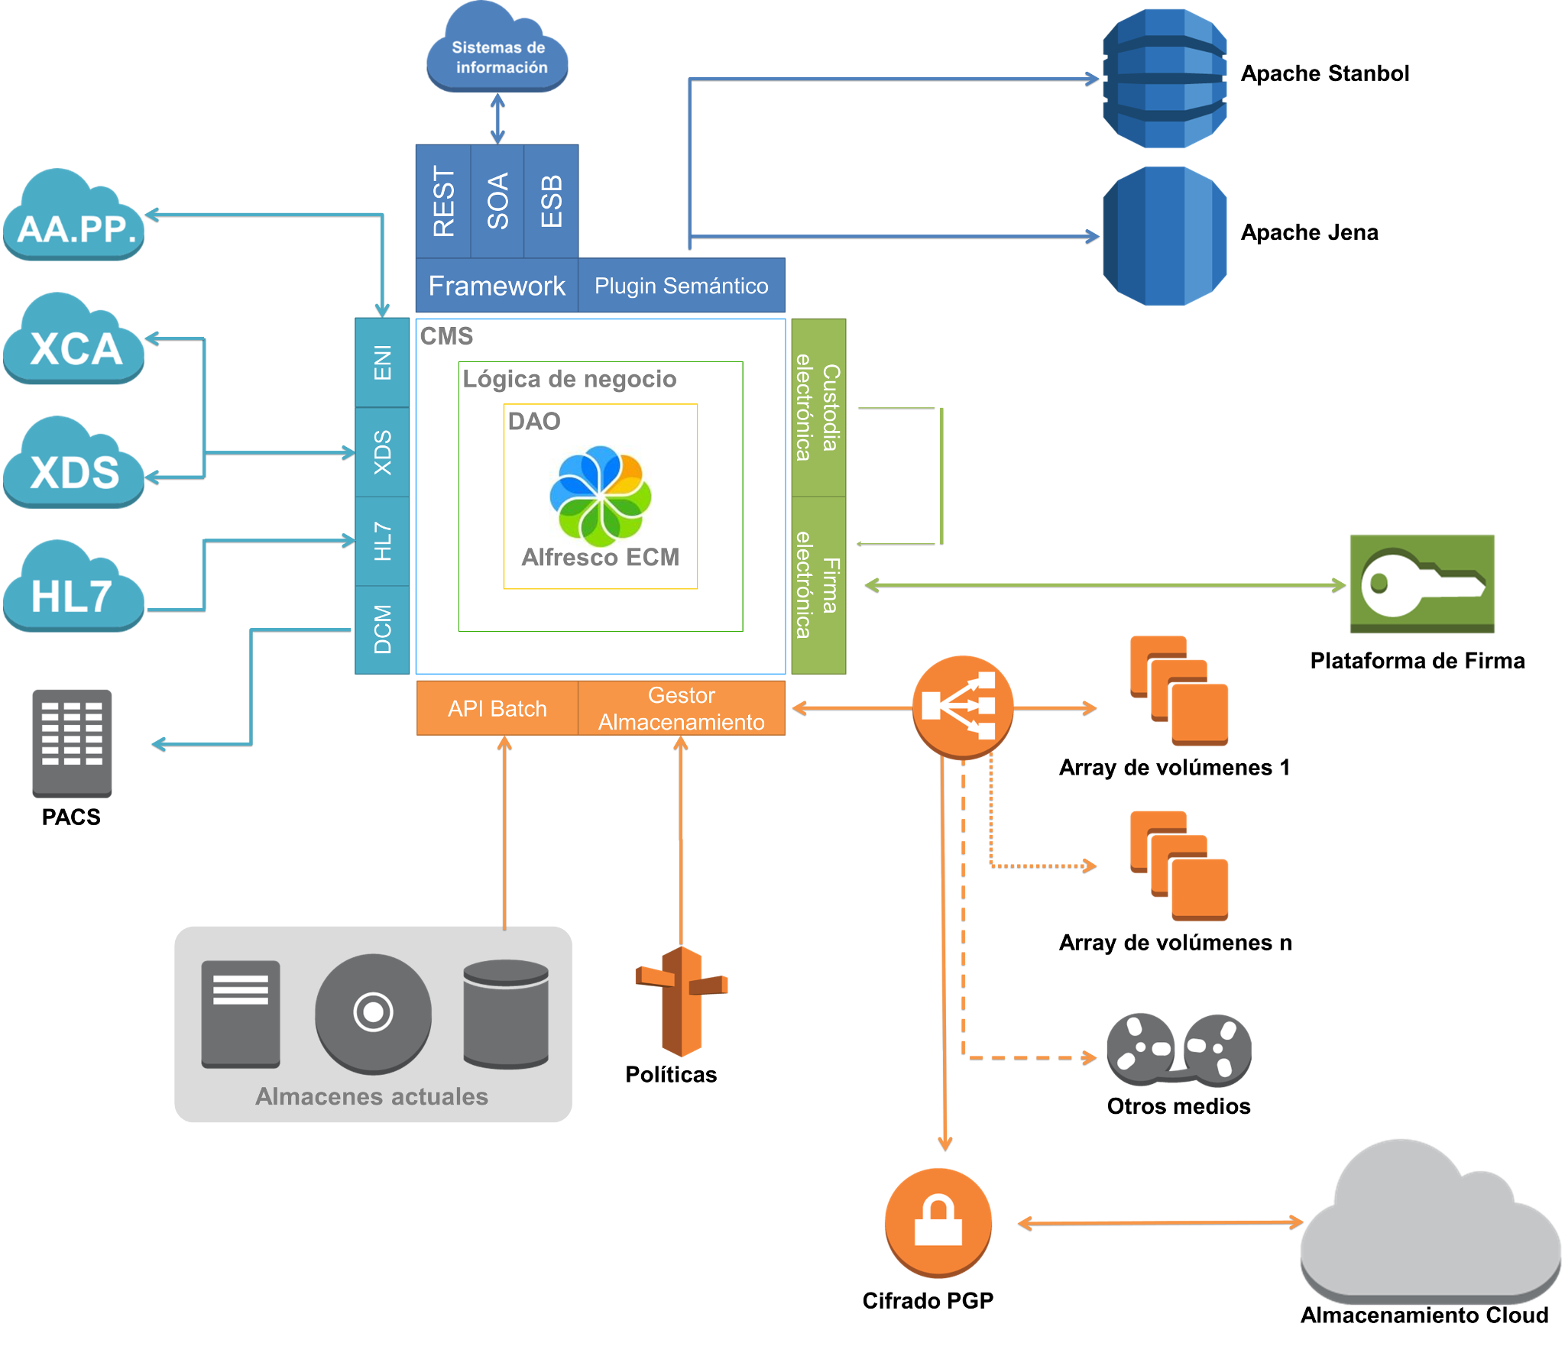
Big picture

Slide 24
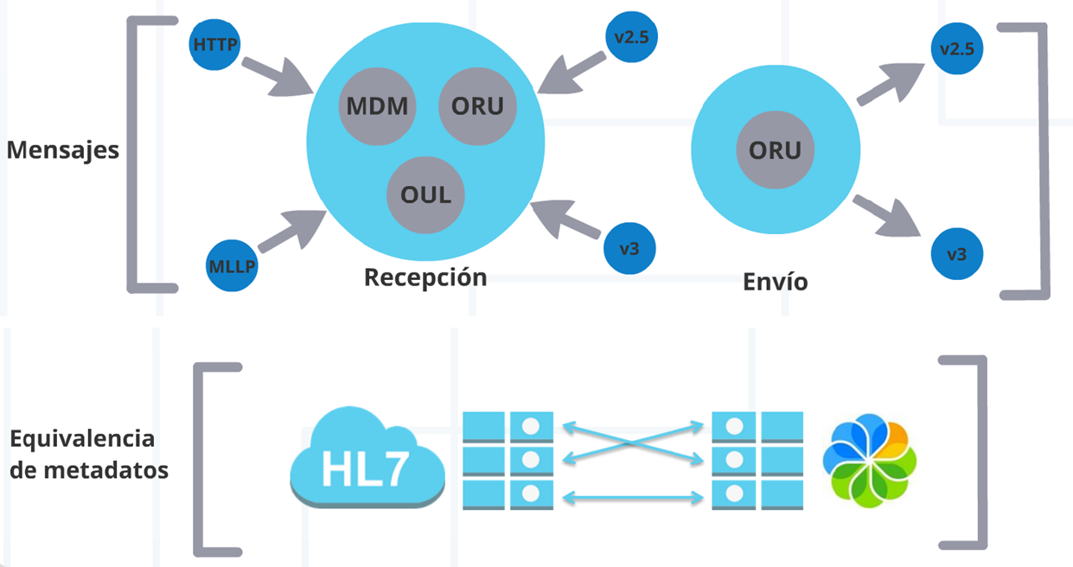
Interoperability Hub: HL7
fhir
fhir

Slide 25
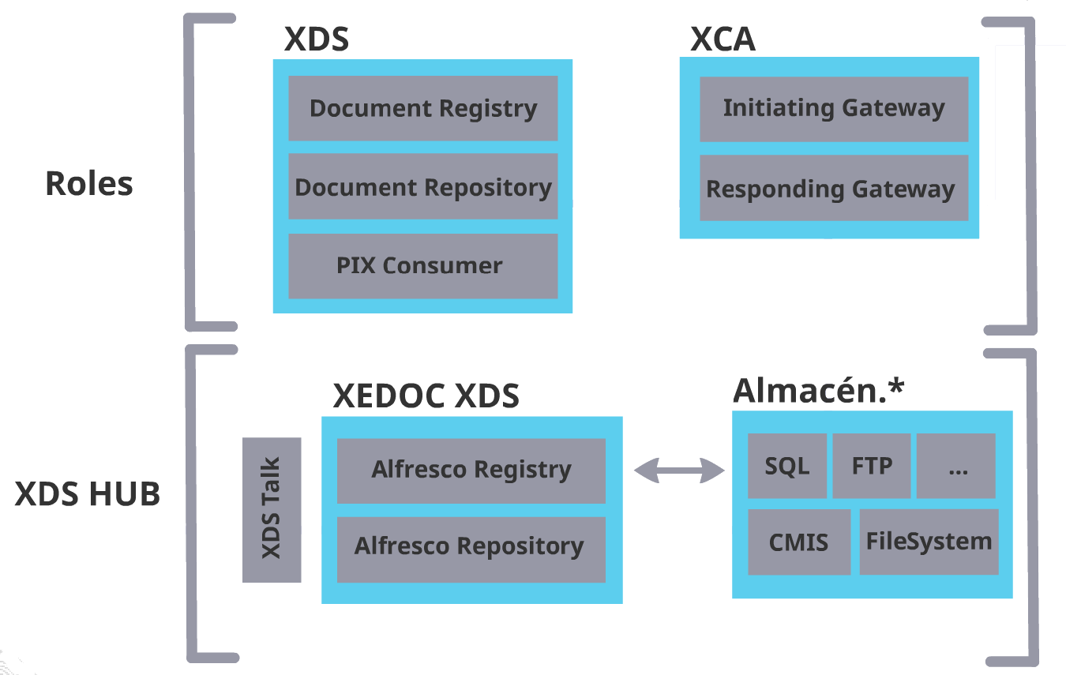
Interoperability Hub: XDS

Slide 26
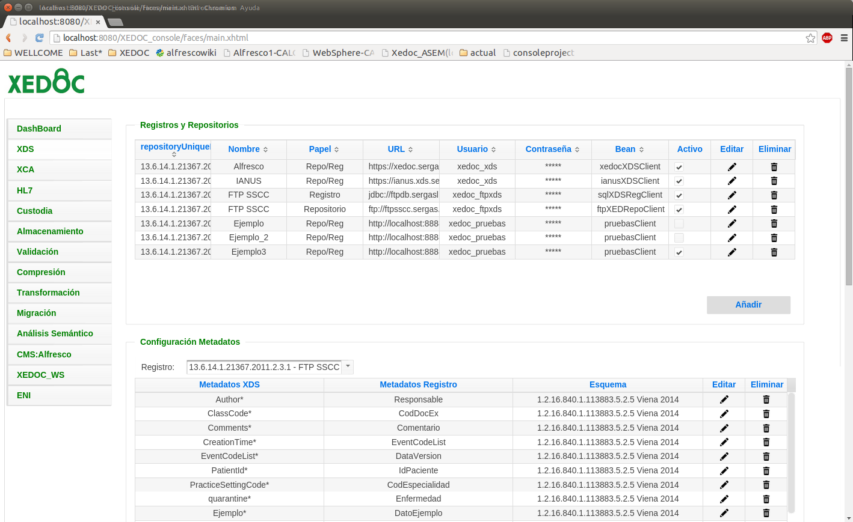
Interoperability Hub: Match tools

Slide 27
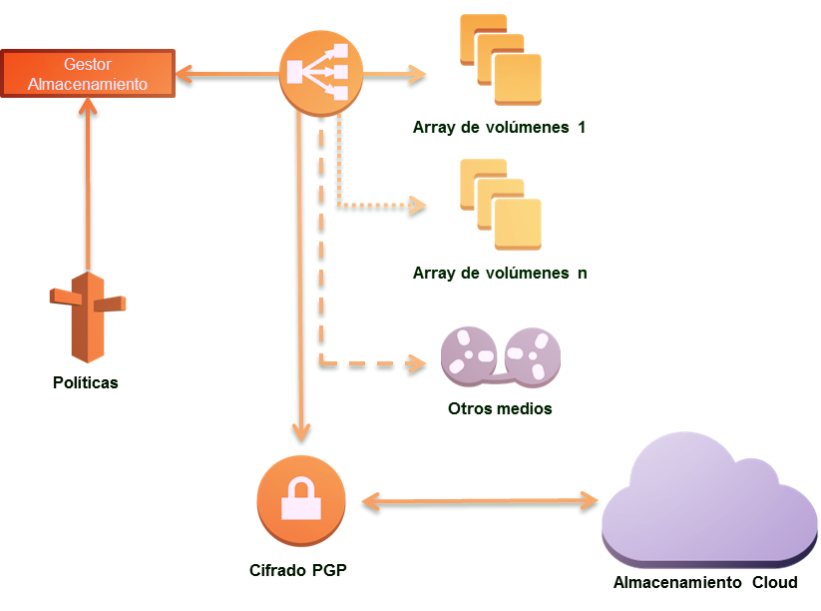
Information Lifecycle Management
Volume Management:
Based on metadata
Based on available space
Closing volumes to optimice backup

Slide 28
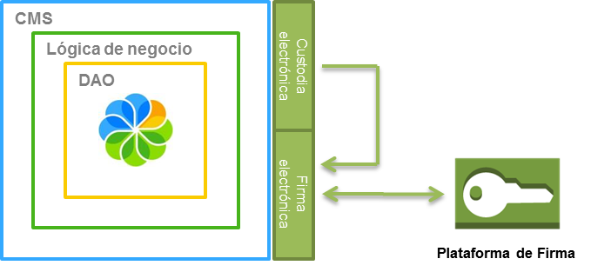
Custody
Promoting digital signature
Re-signing documents
Transformation to long-term access format
Signature platform integration

Slide 29
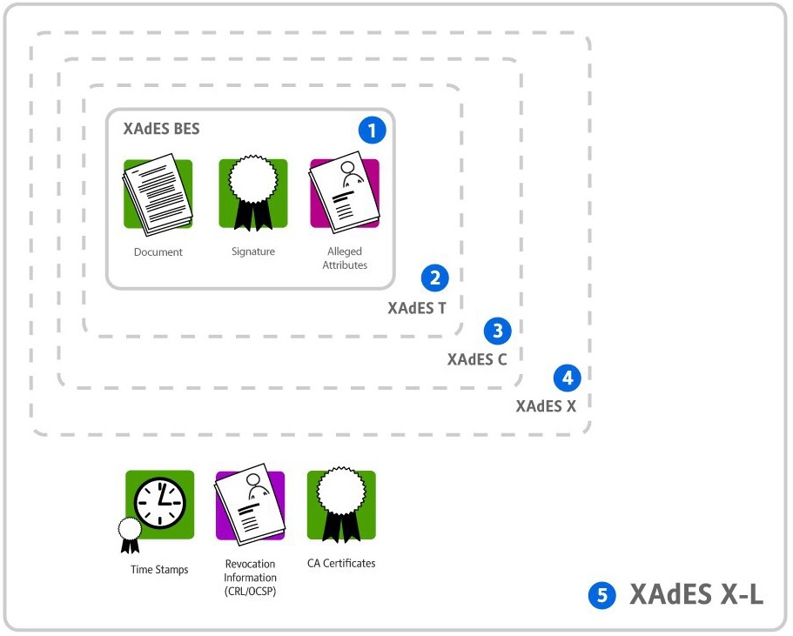
Custody
Notes:
To guarantee that the digital signature was valid in the moment of the signature.
Re-signature: to protect against algorithm obsoloscense

Slide 30
Transformation Server
Digital Signature
When | and | and | Do/execute
{hc}docExt=true | {hc}codCentro=270095 | {hc}contentType=application/pdf | setFirma(“XAdES”)
{hc}docExt=true | {hc}appOrixe=“SEGES” | {hc}contentType=image/jpeg | setFirma(“XaDES_Detached”)
Long-term
When | and | and | Do/execute
{hc}docExt=true | mimeType=“img/png” | {hc}appOrixe=“SEGESDOC” | setTransformacion(“PDF/A”)
{hc}docExt=true | mimeType=“ms/word” | {hc}tipoDoc=“TD14” | setTransformacion(“PDF/A”)
Notes:
Drools basically is a business rules engine that executes java code

Slide 31
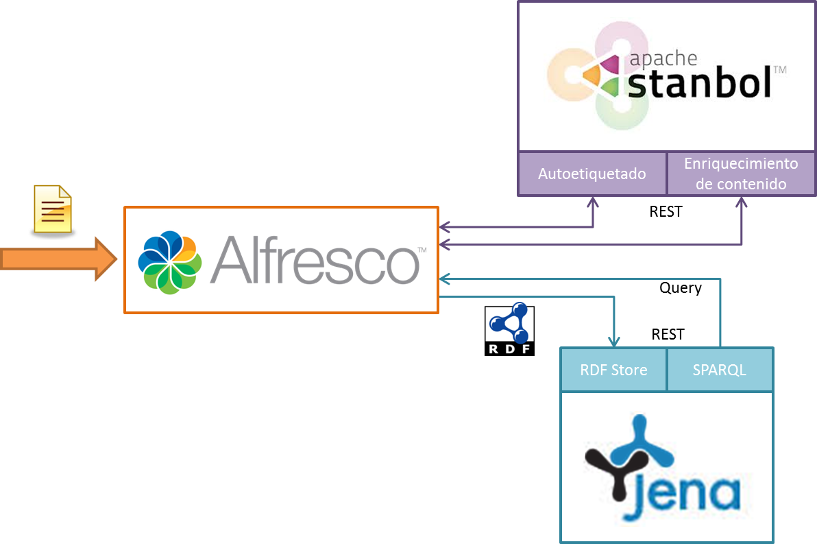
Semantic analysis
Semantic analysis using customizable ontologies
Content Auto-tagging
Content data enrichment
Semantic search

Slide 32
Semantic analysis
Sample of rich content

Slide 33



Migration tool with an API
API Batch
Tools and services to migrate from current repositories
Multiple sources:
FTP, Filesystem, Database, etc …
Intelligent migration systems, that adapts itself depending on the
repository load
Current repositories
Notes:
This allow us to continue to use old legacy systems while we are migrating the repository

Slide 34
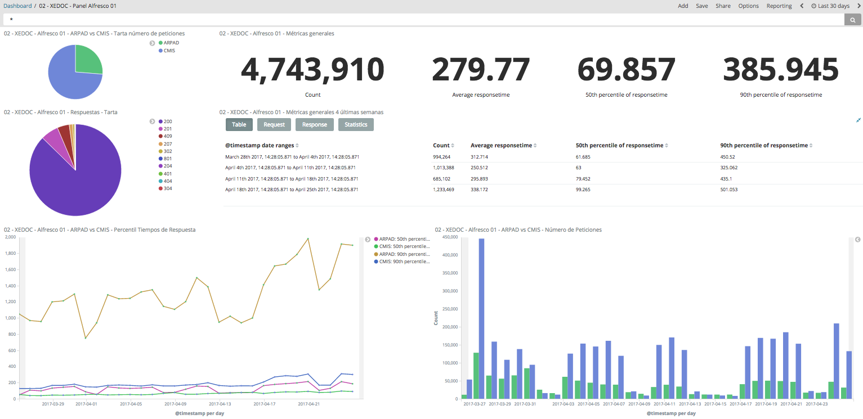
Monitoring Server

Slide 35
Success Case

Slide 36



Sucess Case
EHR Management
Document Management system implementation
Digitization process creation
Duration of 4 years, since 2013
Activities
Architectural definition
Modules development
Installation and configuration
Process definitions
Volume
20.000 documents/day (10 GB)
2.000 request/minute
20.000 users
Team
1 Consultant
1 Architect
2 Developers
1 Administrator
1 Support
Architecture
3 repositoy nodes
3 solr nodes
Alfresco 4.1.8

Slide 37


Success Case
472
20k
18M

Slide 38
Success Case
Response times, in high load situation:
Search: 200 ms
Download documents: 1 s
Add documents: 2 s
High availability with 3 nodes x 4 cores (8 Gb)

Slide 39
The first succes is Peter

Slide 40
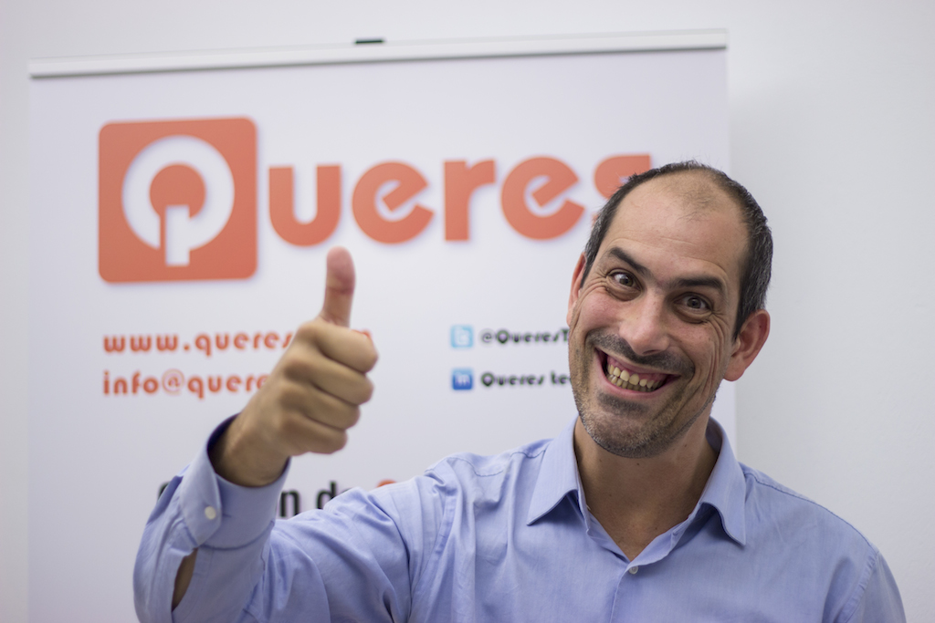
Thanks

Slide 41
Victor Fariña
Victor.farina@queres.com
Twitter: @coffman

